Slide 1
Branch : Computer Engineering
HASMUKH GOSWAMI COLLEGE OF ENGINEERING
Guided By :-
Mr. Hitesh Prajapati
Presented by :-
Utsav Parihar
Urvish Patel
Parth Trivedi
Darshil Modi
Jignesh Suthar

Slide 2
SUBJECT : ELEMENTS OF ELECTRICAL
ENGNEERING
Three phase A.C. Circuit

Slide 3
Introduction
The AC system having a single alternating voltage & current waves known as Single phase system. The system is quite satisfactory for domestic & commercial applications for low rating loads. For ex- motors used for mixers,washing m/c.,fans,refrigerators, water pumps, air conditioners, illumination purpose, day to day use electronic equipments etc.
Due to liminations of single phase system in fields of generations, transmission, industrial applications & huge power rating it has been replaced by poly-phase system. The poly-phase system may be two phase, three phase, six phase or more no. of phases.

Slide 4
In two phase system, two windings displaced 90° electrical apart. Like this, in 3 phase system, three independent windings displaced by 120° electrical from each other.
In poly phase many no. of phases are displaced from each other with appropriate angle of electrical degree.
Thus, AC system having a group of two or more than two phases having equal voltage & frequency arrangement with equal phase angle diff. btw adjacent phases is called POLY-PHASE SYSTEM.

Slide 5
Advantages of 3-phase system
For power system as well as domestic & industrial application, 3-phase system has following advantages over 1-phase system.
For same size of machine,ratin g of machine having 3-ø is 1.5 time the rating of having 1-phase means, rating of machine increases with increase in no. of phases. In other words for same rating machine with 3-phase having smaller size than machine with 1-phase.
Single phase induction motors are not self start due to no starting torque, while in 3-phase motors, no need of starting machine.
Power factor of single phase motors is lower than that of polyphase motors of same rating.

Slide 6
Polyphase motors are more efficient than single phase.
Due to zero power twice in a cycle for even in phase voltage & current, the 1-phase motor librates more while in 3-phase, total power delivered is nearly constant & motor operation is smooth.
There will be saving in conducting material with three phase than single phase(nearly 25% saving in copper than 1-phase).

Slide 7
Generation of 3-phase
In 2-phase altermator, the armature winding are displace 90° electrical apart & in 3-phase 120° electrical apart. Hence, voltage induced in 3-phase are 120° electrical apart in 3 phases. So, in general except 2-phase system, electrical displacement between different phases in 360/n, where n is the no. of phases or windings.
From the figure 2-poles & 3-phase stationary armature are shown.

Slide 8
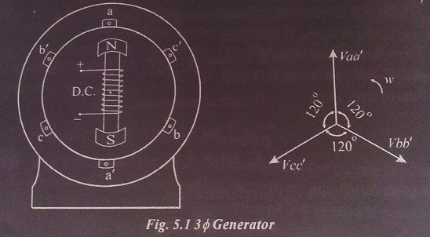
The field winding is on rotating part known as rotor & armature is on stationary part is known as stator of 3-phase A.C generator or alternator.

Slide 9
It has 3 armature coils aa’, bb’ & cc’ displaced 120° apart from each other. For clock wise rotation of poles, it is found that the e.m.f induced in conductor “a” for coil “aa” is maximum when pole axis lies along aa’. The emf in conductor b for coil bb would be maximum when the N-S lies along bb’.
Thus we can say, the induced emf in conductor b reaches its maximum value 120° later than the maximum value in conductor a. In same manner the maximum emf will induced in conductor c, 120° later than that in b or 240° later than that in a.

Slide 10
When the rotor is rotated in clockwise direction at constant angular velocity ω rad/sec, a sinusoidal voltage is generated across each coil & three emf are 120° out of phas(electrical) with one another which will be shown in next slide. As three coils under flux with same velocity of field coil mounted on rotor, frequency & amplitude of emf are equal.
The direction of induced emf in three phases can be found with the help of Fleming’s Right Hand Rule.

Slide 11
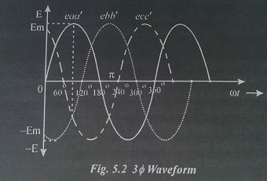
The Instantaneous values of three emfs assuming counting the time from instant when the emf in phase a is Zero.

Slide 12
e_{aa’} = E_{m sin wt …(1)}
e_{bb’}= E_{m} sin(wt-120°) …(2)
e_{cc’}= E_{m} sin(wt-240°) …(3)
where e_{aa’}, e_{bb’} & e_{cc’} are instantaneous values of emfs induced in three coils & E_{m} is max. value of induced emf.
As per discussion, rms value of voltages of three phases are Equal…
E_{a}= E_{b}= E_{c}= E

Slide 13
From three phase wave & relations between three above Eq, it can be proved that sum of three phase emfs is zero.
Sum of three emf = Resultant instantaneous
= e_{aa’} + e_{bb’} + e_{cc’}
=E_{m}sinωt+ E_{m}sin(ωt-120°)+ E_{m} sin(ωt-240°)

Slide 14
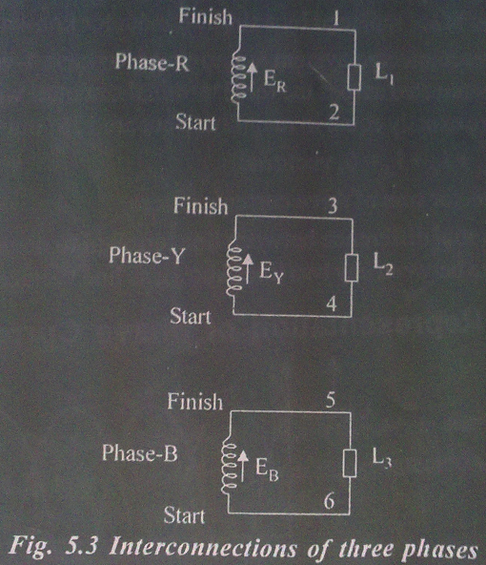
Interconnection of 3-phases
If the 3 armature coils of 3-ø alternator are not interconnected but are kept separate which will shown fig. in another slide., the total no. of conductors are coming out are six.
By connecting these conductors in different manner star or delta connection of 3-ø system is possible.
The interconnection of 3 windings saves copper in connection

Slide 15
The interconnection generally made out of
Two methods…
1- Star or Wye (Y) connection &
2- Mesh or Delta (∆) connection

Slide 16
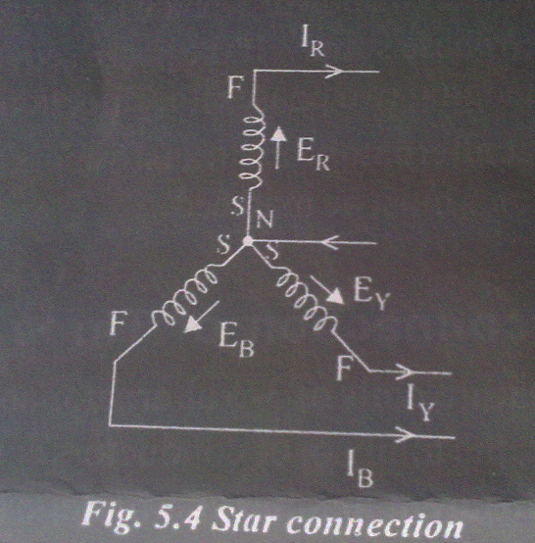
Star or Wye (Y) connection
when finishing ends brought as three terminals of three phases and “star” ends of three phases windings are joined together to make neutral, method of connection is known as Star or Wye(Y).

Slide 17
The common point N is known as Star point or neutral Point. The three conductors meeting at a point N are replaced by a single conductor known as neutral conductor.
This interconnected system is known as 3-phase 4-wire system.
If balanced 3-phase load is connected across the three terminals, neutral wire will be carrying three currents which are exactly equal in magnitude but are 120° out of phase with each other.
Hence I_{R}+I_{Y}+I_{B}=0.
Means vector sum of three currents is zero.
The potential difference between line terminal to neutral is phase voltage and potential difference between any two lines known as line voltage.

Slide 18
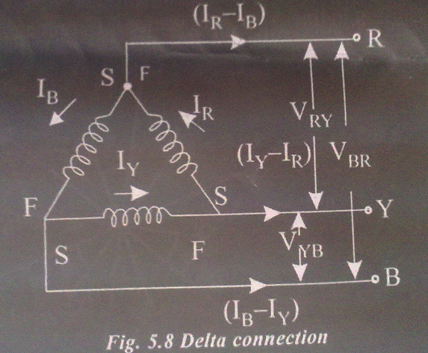
Mesh or Delta (∆) connection
When dissimilar ends of three phase windings are joined together, i.e. ‘starting’ end of one phase winding is joined to ‘finishing’ end of other phase as per interconnection shown in above fig., the system is called as Delta or Mesh connected.

Slide 19
As per connections shown in connection diagram, three windings are joined in series to form a closed mesh and three leads are taken out from three junctions.
When we connect the 3-phase balanced load across the three terminals of delta connected supply system, the sum of three voltages around the closed mesh is zero.
It should be clearly understood that at any instant the emf in one phase is equal and opposite to the resultant of those in the other two phases.
By virtue of connection, this system is known as 3-phase, 3-wire system…

Slide 20
Thank you

